Slide 1
Activity Reporting System
(ARS)
A Crash Course

Slide 2
Presenter
  Carol Livingstone
  Associate Provost for Management Information
  Provost’s Office and the
    Division of Management Information
  livngstn@illinois.edu
Notes:
We are a public institution spending public money.
More than 80% of the money we spend is through payroll, and we need to account for the uses of that money.

Slide 3

Why do we have an ARS?
To comply with Federal and State mandates that we track and report what employees do for the money they are paid.
Fact of life: Money ALWAYS comes
with strings attached
Notes:
We are a public institution spending public money.
More than 80% of the money we spend is through payroll, and we need to account for the uses of that money.

Slide 4
Who requires us to collect faculty & staff activities?
Illinois Board of Higher Education
  Cost Study, since 1965
Federal Government
  OMB Circular A-21, first issued in 1982:
“Cost Principles for Educational Institutions”
http://www.whitehouse.gov/omb/circulars_a021_2004
Granting agencies with cost sharing agreements
Notes:
A-21: defines what costs are “allowable” and “unallowable” for direct charges to Federal Government sponsored projects and for the computation of an overhead rate to be used for indirect costs.

Slide 5


Who enters activities into ARS?
ARS Updater Qualifications
Must understand and have access to the following information:
  Dates and % time for each paid appointment
  Funds charged for the appointment
  HRFE and Banner systems
  Labor redistribution records
  Faculty, academic staff, and grad assignments
  -All cost sharing agreements

Slide 6
ARS Annual Cycle –Aug 16- Aug 15
Dept heads reauthorize users each fall
At least weekly, actual payments from paycalc are merged with appointment data to create an academic year view of all payments YTD and obligated for each employee.
Daily, course assignments are loaded from Banner/EDW so we know who is teaching and what kind of courses are being taught
Upon request, we load cost sharing agreements from files sent to us by Janis Weaver of G&C
Department staff enter activity data continuously through early August

Slide 7
Activity Carryover & Imputing
When a new payment line appears for an employee:
ARS searches last year’s activities for a C-FOAP match and, if found, rolls last year’s activities over to this year.
  (note, we only carry over activity lines that were confirmed by updaters last year)
If no match is found from last year, ARS “imputes” activity where possible. Examples:
    TA appointment on state instr funds → 100% class instruction
    RA appointment on Federal research funds → 100% org research
Some payment lines cannot be imputed (e.g. faculty on state instructional funds)

Slide 8
Activity Data Entry
Department ARS data entry staff are sent periodic reminders to check on activities.
Data entry page shows all payment lines and errors, and allows updaters to make changes in activities reported.
Activities are restricted based on the SOF (source of funds) and NACUBO function code of the payment . Incorrect entries result in an immediate error

Slide 9
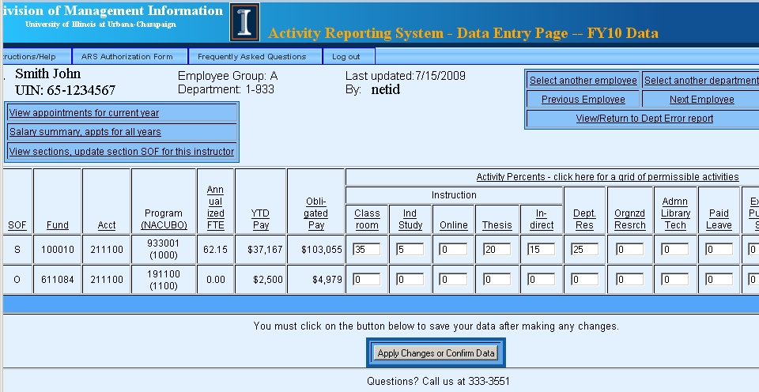
ARS Data Entry Page
Payment , FTE, and C-FOAP from payroll/HR: Depts cannot change these columns
Activities: Depts enter % to divide up the pay and FTE

Slide 10
Entering Activities
Activities must add to 100% on each line
Notes:
This means that when you change the percent on an appointment, you do not have to change the activities. (You may of course)
We know the percent on the appointment from Payroll, so why make you enter it again?

Slide 11
How do data enterers know what people are doing?
Some units poll their employees
Others have formulas – e.g., X% for each lecture course, Y% for each discussion section
You can use last year’s data as a guide, but always adjust it for sabbaticals, changes in teaching load, or major changes in assignments

Slide 12
What Activities can be entered?
Activities are restricted by the type of pay.
-- Example: No teaching activity on
Source of funds=G and NACUBO=1200
If the employee’s activities are not consistent with the SOF and NACUBO, we advise units to do a labor redistribution to a more appropriate source of funds.
If this activity is ongoing, the employee’s budgeted Labor Distribution should include a program code mapped to the correct NACUBO
Notes:
Don’t set up pay lines with SOF=G and NACUBO=1200 for employees who will be teaching!

Slide 13
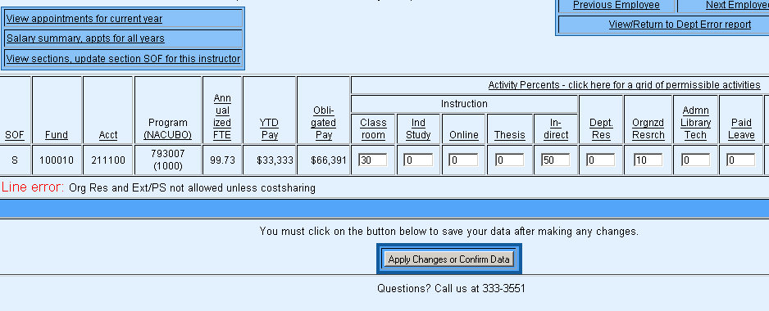
Rules for appropriate activity are posted
Notes:
If you enter an incorrect activity for the SOF, you will get a Line Error after you hit Apply Changes.
The Appropriate Activity Grid – see handout – has all the permitted combinations.
You can view this grid at any time by clicking on the column header over the activities.

Slide 14
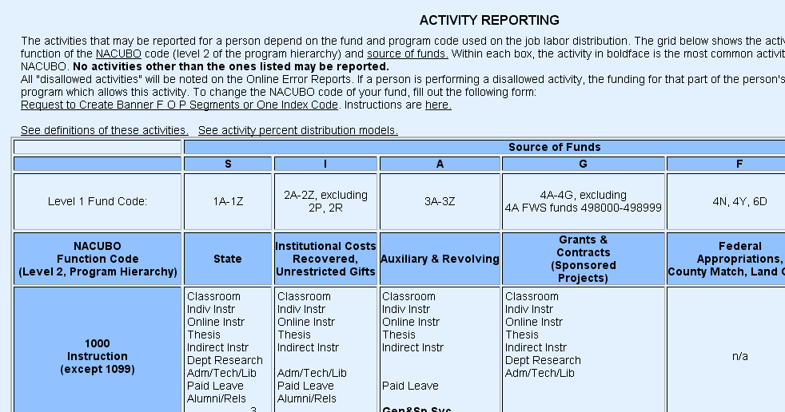
Appropriate Activity Grid
Notes:
Ok, now we will take a look at some examples.

Slide 15
Activity Categories
Instructional Activities
Classroom Instruction
Independent Study
Online Instruction
Thesis Supervision
Indirect Instruction
Other Activities
Departmental Research
Organized Research
Admin/Library/Technical
Paid Leave
Extension/Public Service
Alumni, Development,
Community Relations
General & Specialized Svc
Notes:
In FY0708, due to increasing need to record data related to online courses,
we split “Nonthesis instruction” into
Classroom Instruction
Independent Study
Online Instruction
We will go through all of these today BRIEFLY. – they are defined with examples in the glossary. Just click on an activity column header. SEE the handout.

Slide 16
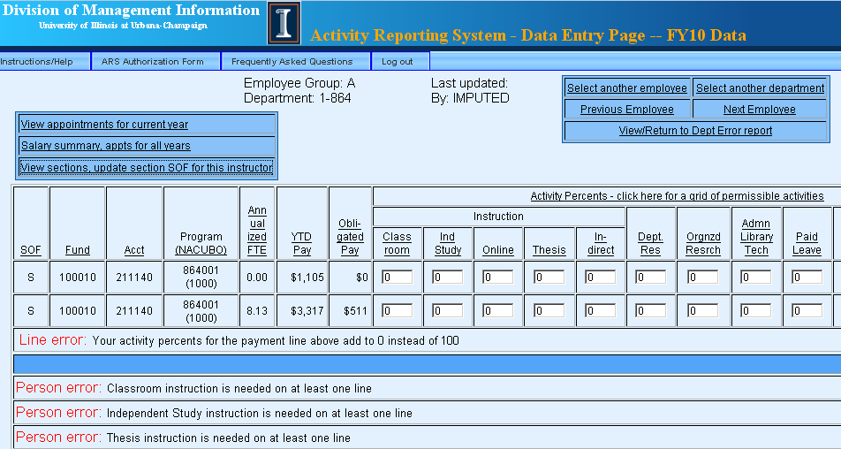
Entering Activity for Courses Taught
Instructional activities are checked against the instructor’s courses; the SOF for each course must match the SOF for the activity
Notes:
You must enter the appropriate instructional activity if a course is funded by your department.
The SOF for the course much match the SOF for the line where you provide instructional activity.
To see the SOF for the course, and to see whether it is thesis or non-thesis, click on the
View Sections link for this instructor.

Slide 17
How is ARS Course Info used?
IUs (credit hours) for each section are assigned to the unit paying the instructor, not to the unit “owning” the course.
Paying department for any section can be changed in ARS
These IUs are used by the Provost’s office to distribute approximately $70 million dollars of tuition income among the colleges.

Slide 18
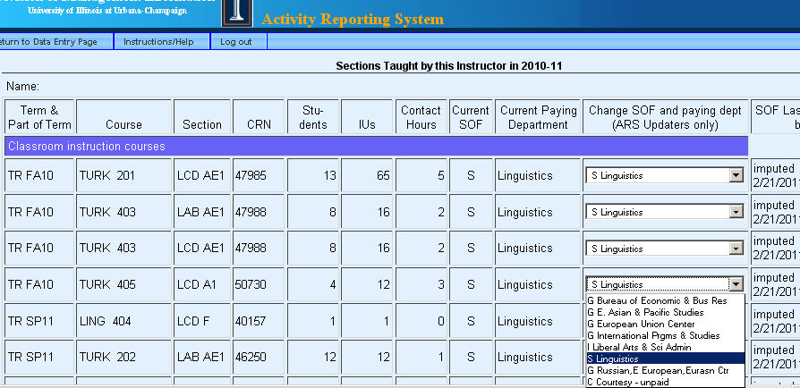
View Sections for an Instructor
All sections taught by this instructor are displayed, even if not funded by your department. Updaters may change the SOF for a course.
Notes:
For each section taught Fall, Spring, and Summer,
we need to know the Source of Funds (SOF)
for each instructor and the department which
provided the funds.
Our computer “guesses” at the right SOF and dept, but
ARS updaters can change these defaults within ARS.
You will need to enter instructional activity (thesis instruction or non-thesis instruction) on a payment line matching the SOF listed here.
NOTE: you can tell if it is an online course (schedule type=ONL), an independent student course (schedule type=CNF) or a thesis course (course number is 599) from this table.

Slide 19
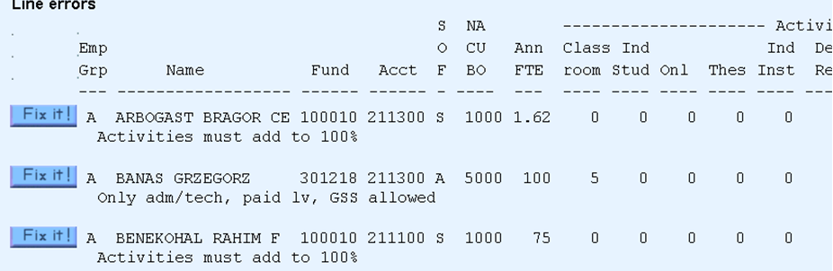
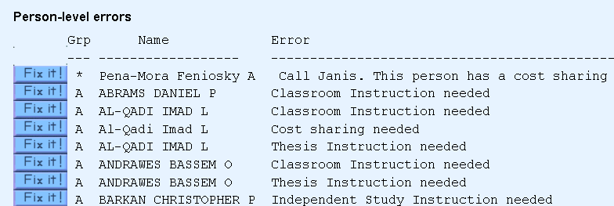
ARS Error Report – Line- & Person-level Errors
Line errors are shown with the line generating the error.

Slide 20
IBHE Cost Study
ARS Inputs and Outputs
Payroll data
($ & FTE) by person and C-FOAP
Unit cost study
Program cost study
Faculty Credit Hour Study
Course data
Instructor
Students enrolled
Credit hours
ARS
A-21 F&A calculation
SOF for each section taught
Cost sharing reporting
Activities reported for each salary line
Internal mgmt reports/budget calcs

Slide 21
ARS Outputs: IBHE Cost Study
The Illinois Board of Higher Education requires universities to report the costs and FTE associated with three functions:
State personnel costs are divided among these functions based on activities reported by each paying department
Other state expenditures are prorated based on the direct salaries allocated to each function
Output is Cost for each function, and
Cost per Credit hour by Level for instructional function
Instruction
Research
Public Service

Slide 22
IBHE Cost Study - Example
Prof. Sampson teaches two on-campus courses, one online course, and one thesis course.
She has a research grant and serves on the departmental P&T committee.
She is paid $100,000 for 9 months on a state NACUBO 1000 (instruction) line.

Slide 23
IBHE Cost Study - Example
Her activities as submitted by the department and the salaries and FTE attributed to them are:
Activity category | Activity % | FTE | Salary
Total | 100% | .750 | $100,000
Classroom instruction | 30% | .225 | $30,000
Online instruction | 10% | .075 | $10,000
Thesis supervision | 5% | .0375 | $5,000
Indirect Instruction | 5% | .0375 | $5,000
Dept research | 40% | .300 | $40,000
Administration/ Library/ Technical | 10% | .075 | $10,000

Slide 24
IBHE Cost Study – Prorating Instruction FTE & $
The .225 FTE and $30,000 for on-campus instruction is further divided between her two classes based on the contact hours for each class.
And within each class, the FTE and dollars are divided up among the students enrolled based on:
student level
    lower division undergraduate (nondegree ugrad, frosh, sophs)
    upper division undergraduate (junior, senior)
    grad 1 (nondegree grad, masters and professional students)
    grad 2 (doctoral students)
student major
Notes:
Contact hours are calculated from class time, but the calculated hours can be overridden by depts in Banner.

Slide 25
Unit Cost Study: $ and $/CH By Academic Dept
State Expenditures Only
Cost type | Instruction |  |  |  |  | Research | Public Service | Total
 | LD | UD | Grad1 | Grad2 | Total
Direct salary
Indirect Instruction |  |  |  |  |  | 0 | 0
Department research |  |  |  |  |  | 0 | 0
Department overhead
College overhead
Subtotal – College and Dept state expenditures
Overhead unique to function
Academic Support
Student services |  |  |  |  |  | 0 | 0
Independent operations
Institutional Support
O&M of Physical Plant
Based on expenditure NACUBO
Notes:
Instructional costs are show in total dollars and as dollars per credit hour
All of Prof. Sampson’s dollars will be shown somewhere in the pink area. Indirect instruction, dept research, and dept overhead (her committee service) will be prorated to student level based on the direct salary dollars for each student level.
Note, none of her pay will be shown as Research or Public service. That’s because the C-FOAP on her payment has a program code with a NACUBO for instruction. Some depts are starting to divide their state money as research and public service as well as instruction.
Department overheads – all state expenses less the salaries already accounted for – are distributed to instruction, research, public service based on the direct salaries line.
College overheads, e.g. Dean’s office, placement office, etc. are distributed to the academic units in the college based on direct salary.
Overhead unique to a function would include costs that of units that serve only one function (instruction, research, public service). Examples are Center for Teaching Excellence, VC Research Office, VC Public Engagement
Academic support, Student Services, Independent Operations, Institutional Support, and O&M of Physical plant are state expenditures from other service units with those NACUBO codes.
The Unit cost study is used to compare departments.

Slide 26
Program Cost Study – By Major
Cost type | LD UD Grad 1 Grad 2 | Total
Direct salary
Indirect Instruction
Department research
Department overhead
College overhead
Overhead unique to function
Academic Support
Student services
Independent operations
Institutional Support
O&M of Physical Plant
Instructional costs are show in total dollars and as dollars per credit hour
Notes:
The Program Cost study is used extensively in the cyclical IBHE review of programs.

Slide 27
Faculty Credit Hour Study – By Discipline
Discipline | Faculty Staff Years |  |  | Credit hours per Staff Year (LD, UD, etc)
 | Instruction LD UD G1 G2 | Research | Public Service
01 Agribusiness, Agr Prod, Agr Science
02 Conservation & Natural Resources
03 Architecture
04 Area Studies
05 Business & Mgmt
06 Accounting
08 Communication
09 Computer & Info Science
etc.
Notes:
Used to compare faculty loads across campuses

Slide 28
ARS Outputs:
F & A Rate Calculation
Federal OMB Circular A-21 requires each campus to justify its F&A charges (the “overhead rate” charged against a grant) based on a careful cost accounting
Defines allowable and unallowable activities to include in the overhead calculation (e.g. sabbatical pay and fund raising may not be included in the calculation of the F&A rate, but library costs may be)
Julie Jarvis will discuss A-21 in greater detail later.
Notes:
Julie will discuss this in greater detail.

Slide 29
Some Features of ARS added to support A-21
Certain activity categories were added so they could be excluded from overhead calculation:
      Paid Leave
      Alumni, Development, Community Relations
      General & Specialized Service
ARS reports errors if a faculty member on sabbatical is not assigned any “Paid Leave” activity
Periodically, we check that all Deans have some activity in Alumni, Development, Community Relations
All zero percent lines are separated out from non-zero percent on the same C-FOP to allow different activities to be reported for administrative appointments
Notes:
Julie will discuss this in greater detail.

Slide 30
ARS Outputs:
Cost Sharing Commitment Verification
When a research grant proposal commits a given FTE or dollar amount that will be spent on the project from other sources of funds, ARS is used to store the time actually spent.
Janis Weaver of G&C is our primary contact for cost sharing and departments are instructed to work with her to resolve CS issues.
Janis provides us with preliminary CS files usually around Dec-Jan and then updates them as commitments change. She monitors the error reports and cost sharing activities reported throughout the year.
The CS files contain only agreements that overlap the current academic year in progress.
Notes:
Julie will discuss this in greater detail.

Slide 31
Cost Sharing: What DMI tells Updaters
Cost sharing is a promise by your department to use departmental resources for a project partially funded by a grant.
When cost sharing is defined as a fraction of a person’s FTE over a given time period, ARS is used to record the fulfillment of that commitment.
Cost sharing activity must be recorded on an ARS pay line with a NACUBO consistent with the grant’s NACUBO.

Slide 32
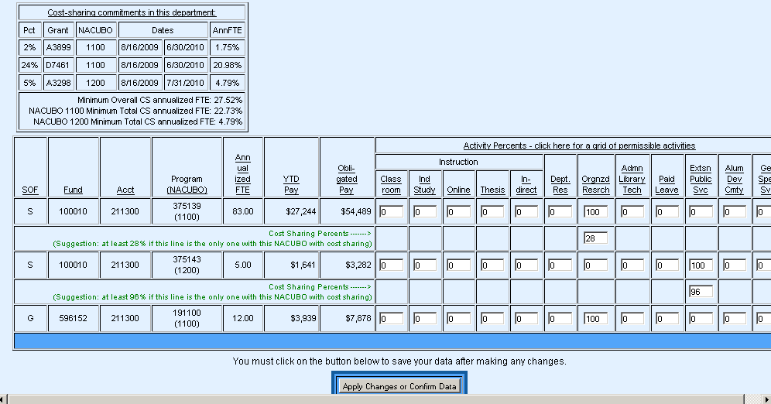
Cost Sharing: Example
Cost sharing commitments for this person.
*
*
* A new line is added under each line appropriate for cost sharing with a “suggestion” for the cost sharing percent.
Percents entered on cost sharing lines do not need to add up to 100%.
Cost sharing percents may not exceed the percent on the activity line above.
Notes:
When a cost-sharing arrangement is in place for this department, the box will show the agreement.
Any activity line that is appropriate for cost sharing will have a new set of boxes below where you enter the cost sharing percents.
Cost sharing lines – unlike activity lines -- do not need to add to 100% (and rarely do)
Only appropriate activities may be used for cost sharing. See how the NACUBO 1100 line can only cost share on Org Res and the NACUBO 1200 line can cost share only on Extension/Public Service.
Cost sharing percents must be less than or equal to the activity line.
For instructional activities, cost sharing must be less than the activity line
(we insist that some time be left for the course).
If the person has a commitment and no cost sharing lines are shown, you have not paid the person on any line appropriate for cost sharing. Call Janice.

Slide 33
Cost Sharing Example
Note: NACUBOs on grants must match NACUBOs on paylines
If a cost sharing commitment exists but no cost sharing lines show up for data entry, you have not paid this person out of the proper source of funds.

Slide 34
Cost Sharing – Other ARS features
Campus-wide cost sharing activities report
  All activities & cost sharing for anyone with a cost sharing commitment
Cost sharing commitments report
  A list of all cost sharing commitments in the system joined with a list of the ARS updaters and contact information for each department.
Department cost sharing activities report
  All activities & cost sharing for anyone with a cost sharing commitment in the selected dept. Catches people who lack any appointment in the dept

Slide 35
Activity Reporting System
A Crash Course
Questions?????

