Slide 1

Activity Reporting System (ARS)
Beyond Checking The Boxes…
10:30-11:45 and 3:15-4:30
April 6, 2011

Slide 2
Workshop Presenter(s)
Julie Jarvis
Senior Director, Government Costing
OBFS UIUC Government Costing
jjarvis@uillinois.edu
Carol Livingstone
Associate Provost for Management Information
Provost’s Office and the Division of Management Information
livngstn@illinois.edu
Elizabeth Clawson (Liz)
Associate Director of Budget
College of Applied Health Sciences
clawson@illinois.edu

Slide 3
Please …
Turn off cell phones.
Avoid side conversations.
Feel free to ask questions at any time
Sign the attendance roster.
Complete the evaluation at the end of the workshop.

Slide 4
Workshop Objectives
Understand the importance of ARS data as used for various processes and reports
Learn about interfaces of the ARS with other systems
Discover best practices for ARS use and data entry

Slide 5
ARS & related training sessions
ARS Annual Update & Training
Jan-Feb. each year, all users are invited
Grants and Sponsored Projects: Cost share http://training.obfs.uillinois.edu/index.cfm?campus=U
F&A Basics Workshop: It Takes More than a Plinko Board
  (Upon request of Government Costing)

Slide 6

Why do we have an ARS?
To comply with Federal and State mandates that we track and report what employees do for the money they are paid.
Fact of life: Money ALWAYS comes
with strings attached

Slide 7
State of Illinois mandate
Illinois Board of Higher Education Cost Study, since 1986:
Universities must report state expenditures and FTE for the three major functions of a university:
Instruction
Research (NACUBO 1100)
Public Service (NACUBO 1200)

Slide 8
NACUBO Function Code
= Second level of the Program Code hierarchy
Coding system for standard functions of universities established by the National Association of College and Universities Business Officers:
1000 Instruction
1100 Organized Research
1200 Public Service
1300 Academic Support
1400 Student Services
1500 Institutional Support
All money arrives in a department with a NACUBO code attached. That’s what you are supposed to spend the money on!
1600 Operations & Maintenance
1700 Scholarships & Fellowships
2000 Auxiliary Enterprise
4000 Independent Operations
5000 Stores and Services

Slide 9
IBHE Cost Study – 3 major reports
  Unit Cost Study
    How much does it cost per credit hour for each unit to offer courses? How much does each unit spend on instruction, research, public service?
  Program cost Study
    How much does it cost per credit hour to teach a student in each program?
  Faculty Credit Hour Study
  What are the faculty workloads?
  (credit hours/faculty FTE, students/faculty FTE)

Slide 10

Federal Mandates
  The Federal Government is very interested in ALL of our activities
Research
Instruction
Other Institutional Activities
Public Service

Slide 11
Federal OMB Circular A-21, J10b(2)
  “The payroll distribution system will…(ii) reasonably reflect the activity for which the employee is compensated by the institution; and (iii) encompass both sponsored and all other activities on an integrated basis, but may include the use of subsidiary records.
  “Direct cost activities and F&A cost activities may be confirmed by responsible persons with suitable means of verification.”
  “will allow confirmation of activity allocable to each sponsored agreement and each of the categories of activity needed to identify F&A costs and the functions to which they are allocable.”
  “the payroll distribution system may reflect categories of activities expressed as a percentage distribution of total activities.”

Slide 12
Federal OMB Circular A-21, cont’d
  Direct (sponsored projects activities): ARS becomes the basis for semi-annual direct cost confirmation of direct costs on sponsored projects (showing related effort percentage)
    Cost Share FTE is captured to move from originating source activity and moved to project activity (function)
  Indirect (F&A cost activities): ARS becomes the basis for identifying FTE statistics related to administration, auxiliaries, service activities, paid leave, etc.
  F&A Calculation: FTE of ALL activities becomes the basis for allocation of use of space which in turn allocates all of the Facilities costs in the F&A study

Slide 13
The F&A Allocation
Based on FTE by dept by building
Room surveys for MRU/DRU
Cost Share FTE moved from/to
Space
Sq Ft
=
Building
Depreciation
Space
Sq Ft
Interest
Space
Sq Ft
NUMERATOR
Facility Pools
Operations
& Maintenance
Space
Sq Ft
Allocation Method
Equipment
Depreciation
Space
Sq Ft
Library
FTE /
S&W
DENOMINATOR
Admin
MTDC
Organized
Research
Instr & Dept
Research
Other Sponsored
Activity
Other Inst.
Activity

Slide 14
Cost Sharing Commitment Verification
What is cost share?
  It is a commitment to use University resources in support of a sponsored project.
  Cost sharing of University resources is most commonly seen in the form of contributed effort (i.e. University supported salary), but cost sharing can include other items.
  Contributed effort is captured and tracked in the Post-Award cost-sharing system as a percentage of a person’s academic year FTE for a specific time period. Cost share data for the AY is periodically uploaded to ARS. The department is responsible for maintaining ARS records and distributing the effort/activities for the individual that are related to the cost-sharing commitment.

Slide 15
Cost Sharing, continued
Executed awards with contributed effort cost sharing commitments
  Contributed effort is captured in the Post-Award cost sharing system and uploaded to ARS; the portion of the FTE committed as cost share is assigned to the cost pool related to the project’s NACUBO function (i.e. research, public service) for use in the F&A rate study and other reporting requirements.
  Contributed effort is reflected in the semi-annual confirmation process by GCO; it is important for the department/PI to verify the % effort and the dates of the contributed effort commitment are accurate.
  Janis Weaver at GCO is the primary contact for cost sharing questions/issues with ARS records; departments should work with Janis to resolve cost-sharing questions/issues with ARS records. Other cost-sharing questions/issues should be referred to Post-Award personnel in the section administering your award (NSF, HHS, State IL, Private, etc.)

Slide 16
Other critical operations that use ARS
For the F&A
Space Study
Library Study
Other Federal Rates using ARS data
Tuition Remission Rate Calculations
Service Activity Rate Calculations
Graduate Assistant Health, Life, Dental Benefit Rate

Slide 17
How is ARS activity & cost share information collected?
Through a web system located at http://www.dmi.illinois.edu
Department Executive Officers reauthorize ARS updater access each fall
    Unfortunately, the updater may not understand the importance of entering accurate activity information…..or the updater may not have time or knowledge to do the job properly
    Best Practice – Business managers need to educate and communicate the importance of this job

Slide 18


ARS Updater Qualifications
Must understand and have access to the following information:
  Dates and % time for each paid appointment
  Funds charged for the appointment
  HRFE and Banner systems
  Labor redistribution records
  Faculty, academic staff, and grad assignments
  -All cost sharing agreements

Slide 19
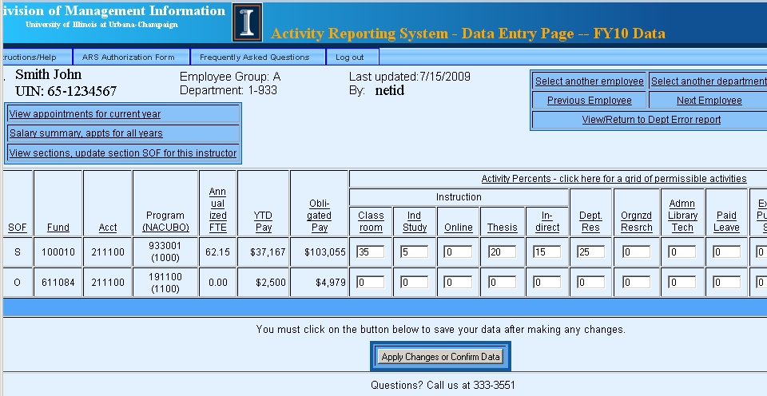
Sample ARS Data Entry Page
Payment , FTE, and C-FOAP from payroll/HR: Depts cannot change these columns
Activities: Depts enter % to divide up the pay and FTE

Slide 20
Activities are limited by the fund and NACUBO
See “Appropriate Activity Reporting” grid in handouts
It’s critical to appoint people on the right source of funds & NACUBO for the type of work they do.

Slide 21
Entering Activity information
Activities must be entered for each non-zero percent line for academic and grad staff
Activities entered must be consistent with the fund source and the NACUBO of the program code
Error messages pop up when activity is on the wrong NACUBO or when you are missing required instructional or cost sharing activities.

Slide 22
What are the Activity Categories?
Instructional Activities
  Classroom instruction
  Independent Study
  Online Instruction
  Thesis Supervision
  Indirect Instruction
Other Activities
  Departmental Research
  Organized Research
  Admin/Library/Tech
  Paid Leave
  Extension/Public Service
  Alumni, Development, Community Relations
  General & Specialized Svc.
Notes:
Web site has full definitions and examples.

Slide 23
Course information in ARS
Every section taught by each employee in a department is available in ARS.
Each section is initially assigned to a department and source of funds based on the payments made to the instructor.
Updaters can change the department and source of funds for any section taught by someone they pay.

Slide 24
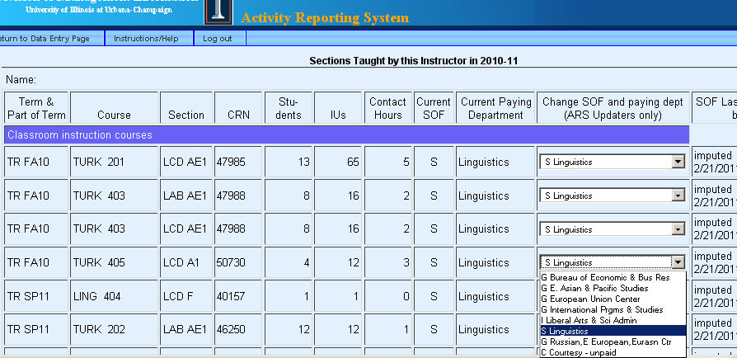
Changing Course SOF in ARS
Notes:
Computer takes a best guess at assigning courses to a SOF and dept for each instructor – state instructional money in the same dept that offered the course is first choice, followed by state instructional $ in the school or college, then state instructional $ in any college. We try to avoid using non-state money, but sometimes have to if there is no state money.

Slide 25
How is ARS Course Info used?
IUs (credit hours) for each section are assigned to the unit paying the instructor, not to the unit “owning” the course.
These IUs are used by the Provost’s office to distribute approximately $70 million dollars of tuition income among the colleges.

Slide 26
What happens when there is bad info in ARS?
Unit may lose credit for IUs & budget that follows IUs
Departments and programs are targets for elimination when costs are high
Faculty workload may be over- or under-stated relative to peer departments
Faculty may not get P&T credit for sections taught
External Auditors may require repayment of millions of dollars in grant funds
A-133 Audit findings can jeopardize future UIUC eligibility for federal grants
F&A Rate may be set too high or low

Slide 27
An all-too-common scenario
Faculty member promises a lab tech will work 10% over the year on a sponsored project as part of a cost sharing agreement.
No one tells the Business manager, who appoints the lab tech 100% on grant funds.
No state money is available for the cost sharing, so the department technically is in violation of its contract.

Slide 28
Consequences?
Best case: Department may have to submit labor redistributions for the entire year to move enough pay to state funds
Worse case: Grant may be rescinded, department may have to pay sponsor back for the entire project.
Even worse: Campus may be punished by the agency and not be eligible for future grants from that agency
Absolute nightmare: campus may be fined millions of dollars or be required to repay grants from multiple federal agencies
Notes:
Florida International University was fined $11.5 million in 2005 for inaccurate cost sharing reporting on a 55 million dollar grant.
In 2004, Harvard University and an affiliated teaching hospital agreed to pay a total of $3.3-million concerning allegations of improperly accounting for four research-and-training grants totaling $5.5-million.

Slide 29
Some examples ….
2003: Northwestern: $5.5 million for failure to comply with effort reporting requirements
2004: Johns Hopkins: $2.6 million for researchers overstating the time spent on federal projects
2004: Harvard: $3.3 million for overbilling NIH on a federal project
2005: Florida International University: $11.5 million for inaccurate costsharing

Slide 30
Nine Best-Practice Tips for ARS updaters
Make sure employees are paid on the right fund and program code from day one
Monitor faculty/staff changes in assignments
Make sure courses are assigned to the right payment lines
Eliminate all ARS errors
Check back after each pay calc for new errors

Slide 31
Nine Best-Practice Tips for ARS updaters
Always review each person’s activities at least once a year. There may be activity changes due to:
  Buy-outs from teaching duties
  Additional teaching duties
  Awarded grant activity
  New appointments
  Additional assignments, e.g. development work

Slide 32
Nine Best-Practice Tips for ARS updaters
Develop departmental procedures to track grant proposals, effort commitments, and cost sharing agreements
Don’t wait until August to start – it’s too late to do labor redistributions
Call us any time you have questions

Slide 33
ARS interfaces with other areas
Accurate information into the ARS system means accurate outputs:
  To other systems
  To reports

Slide 34
ARS interfaces with other areas
Payroll data
($ & FTE)
by C-FOAP
Unit cost study
IBHE Cost Study
Program cost study
Course data
Instructor
Students enrolled
Credit hours
Faculty Credit Hour Study
ARS
A-21 F&A calculation
SOF for each section taught
Cost sharing reporting
Activities for each salary line
Internal management reports

Slide 35
ARS Annual Cycle –Aug 16- Aug 15
Weekly, actual payments from paycalc are merged with appointment data to create an academic year view of all payments YTD and obligated for each employee.
Daily, course assignments are loaded from Banner
Upon request, we load cost sharing agreements from files sent to us by Janis Weaver of G&C
Department staff enter activity data continuously through early August
DMI, G&C use final frozen data and prepare reports and files for state and federal government

Slide 36
Other important contacts
ARS questions: Liz Stern & Mary Sappenfield 333-3551
Cost Sharing questions: Janis Weaver
244-4758

Slide 37
Workshop Summary
Activity reporting is mandated by federal and state governments
Persons authorized to update activities must have extensive knowledge of employee assignments and payment sources
Errors can be very costly
We’re here to help!

Slide 38
Questions / Concerns?

